Slide 1
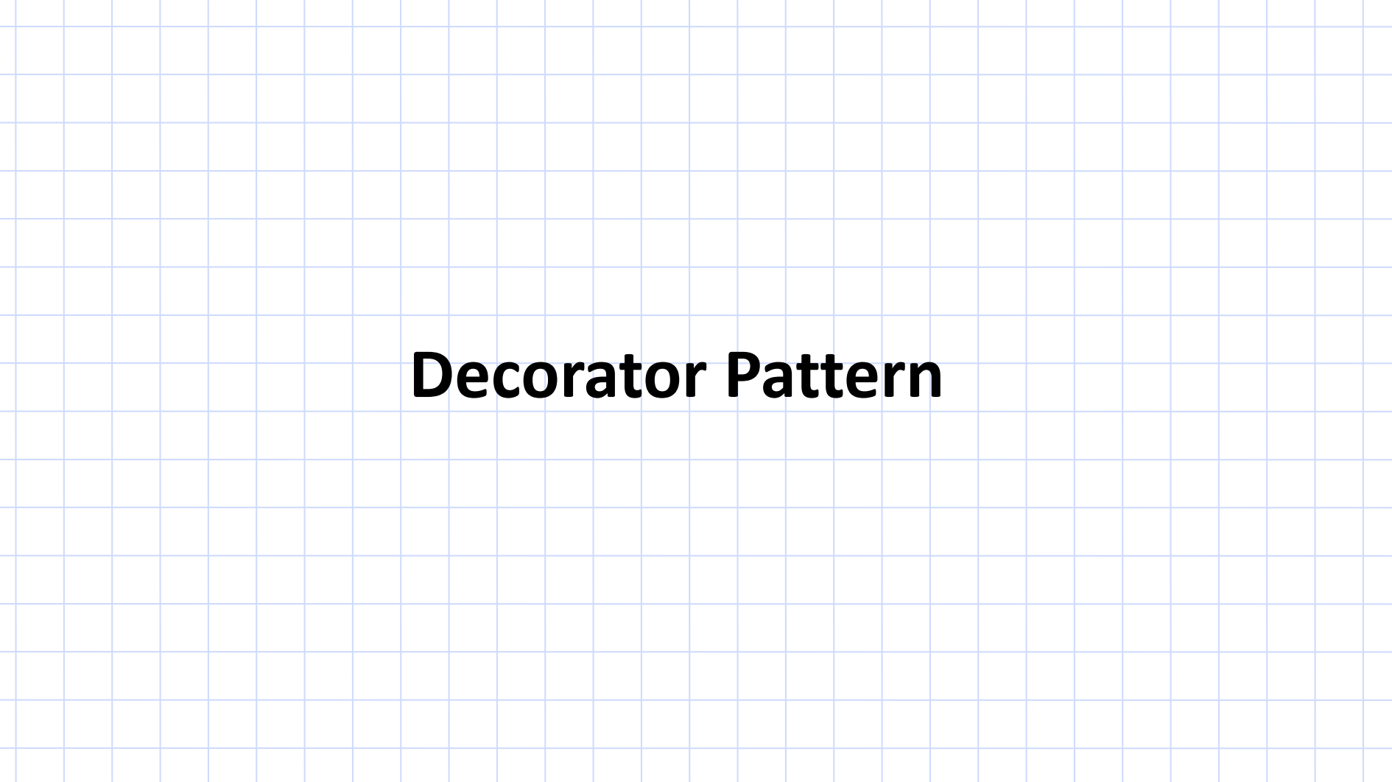

Slide 2

Decorator Pattern

Slide 3
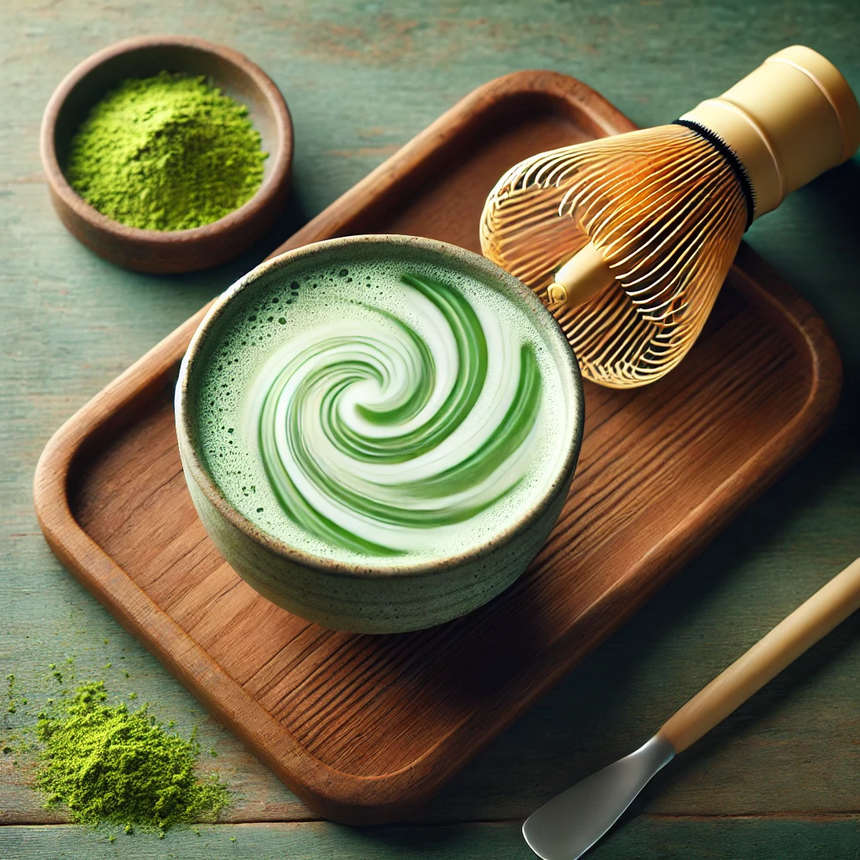

Slide 4
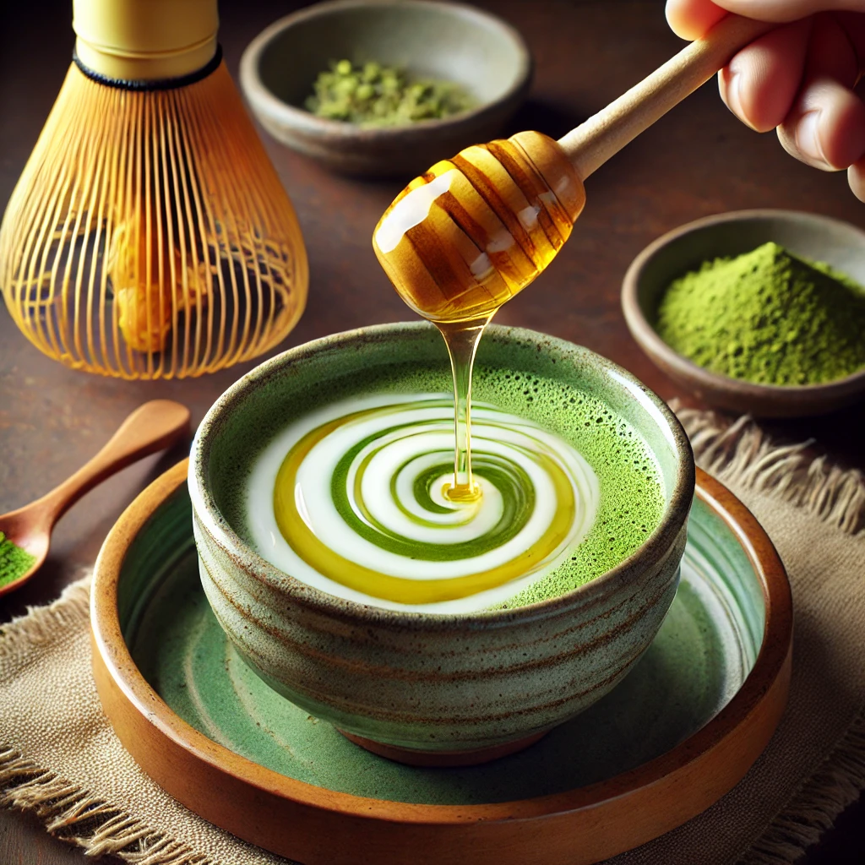


Slide 5
Decorator Pattern
Decorator #1
Decorator #2
Base Object
Decorator #3

Slide 6
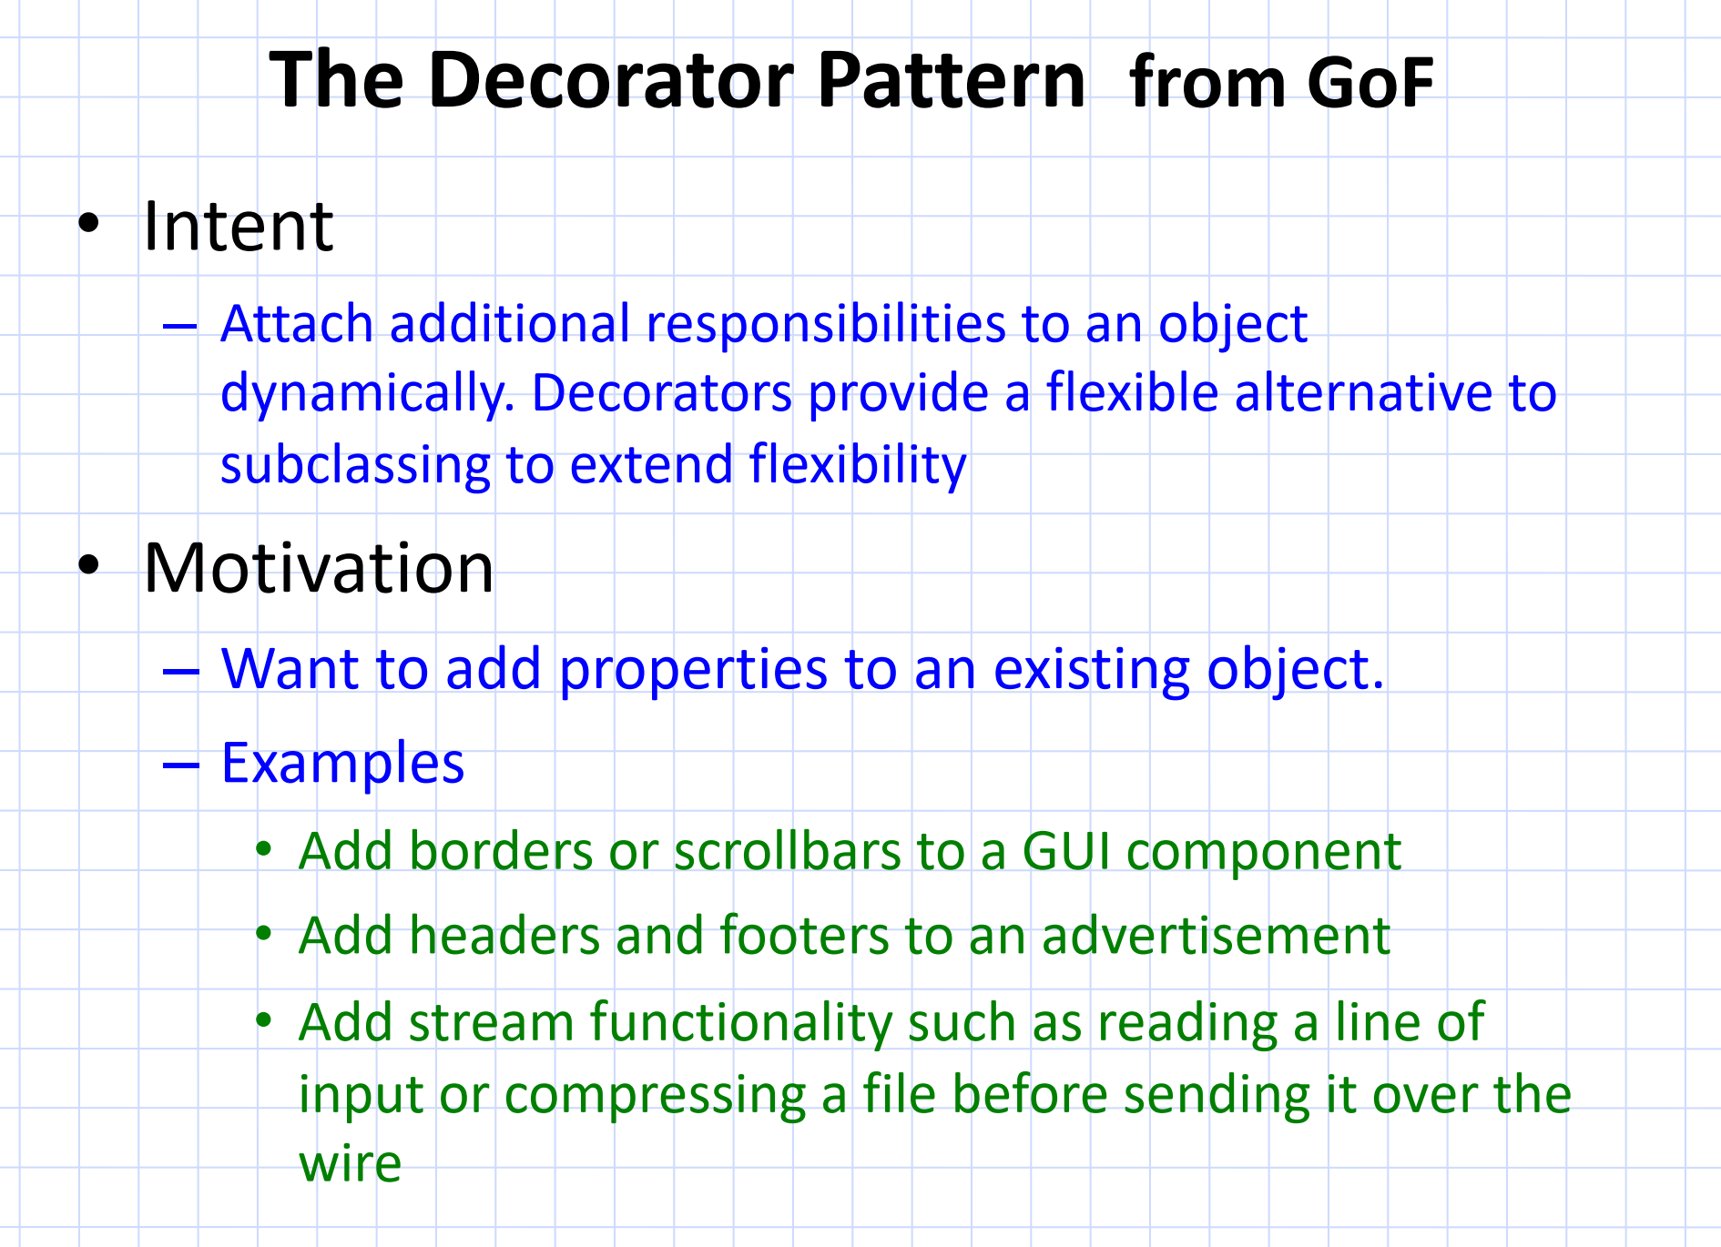
Notes:
Intent
Definition: The main goal of the Decorator Pattern is to attach additional responsibilities or behaviors to an object dynamically. This means you can add new functionality to objects at runtime without modifying their structure or code.
Alternative to Subclassing: Instead of using inheritance (subclassing) to extend the functionality of an object, decorators offer a more flexible approach. With subclassing, you need to create multiple subclasses for each new feature combination, which can quickly become unmanageable. In contrast, decorators allow you to mix and match features dynamically, making the system more modular.

Slide 7
Notes:
otivation
Why Use the Decorator Pattern?
You may want to add properties or behaviors to an existing object, but you don’t want to alter its underlying class. This allows you to modify objects in a non-intrusive way.
Instead of creating complex, rigid hierarchies of classes, decorators allow you to create flexible, reusable components that can extend functionality as needed. Decorators wrap the existing object and augment it with additional capabilities.

Slide 8
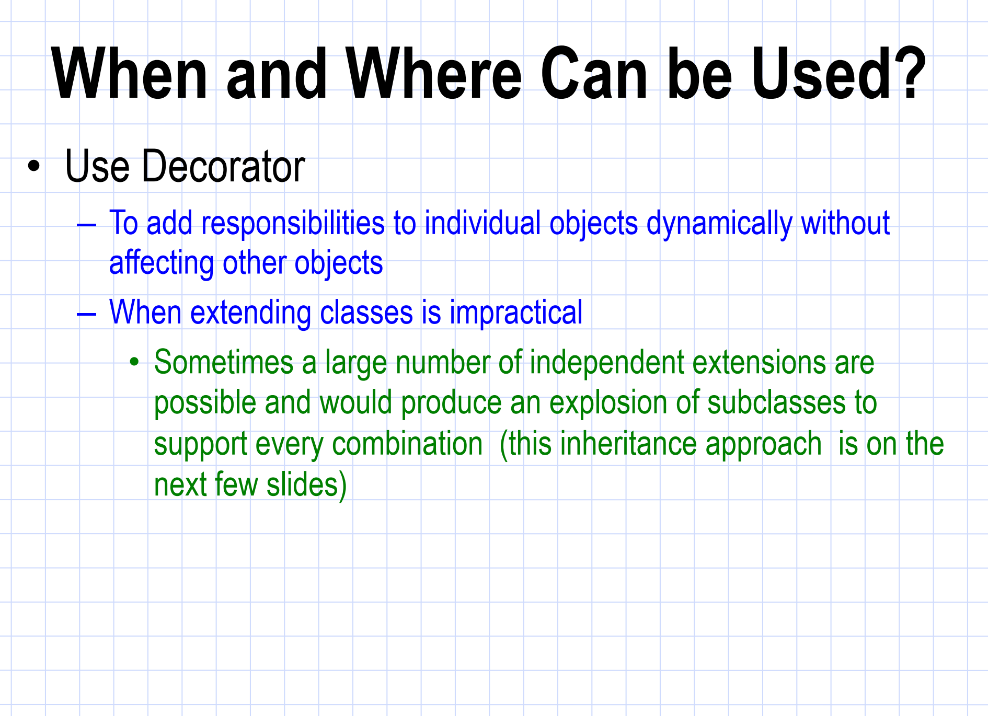
Notes:
To add responsibilities to individual objects dynamically without affecting other objects:This means you can apply additional features or behaviors to one specific instance of a class, without altering other instances or the class itself. This is a key advantage over inheritance, where changes in a subclass would affect all instances of that subclass.
For example, if you want to add new functionality (like "Honey" or "Almond Milk" in a beverage), you can do it on a per-object basis. The original object remains unmodified, but the decorated version has additional behavior.
When extending classes is impractical:The Decorator Pattern is especially useful when using inheritance becomes difficult or impractical. If every new feature required a subclass, the number of subclasses would quickly grow out of control.
For example, if you wanted to support every possible combination of features for a window in a GUI (scrollbars, borders, resize capability, etc.), you would need a new subclass for every possible combination. This would lead to an explosion of subclasses and become hard to manage. The Decorator Pattern avoids this by dynamically adding features through composition, rather than creating new subclasses.

Slide 9
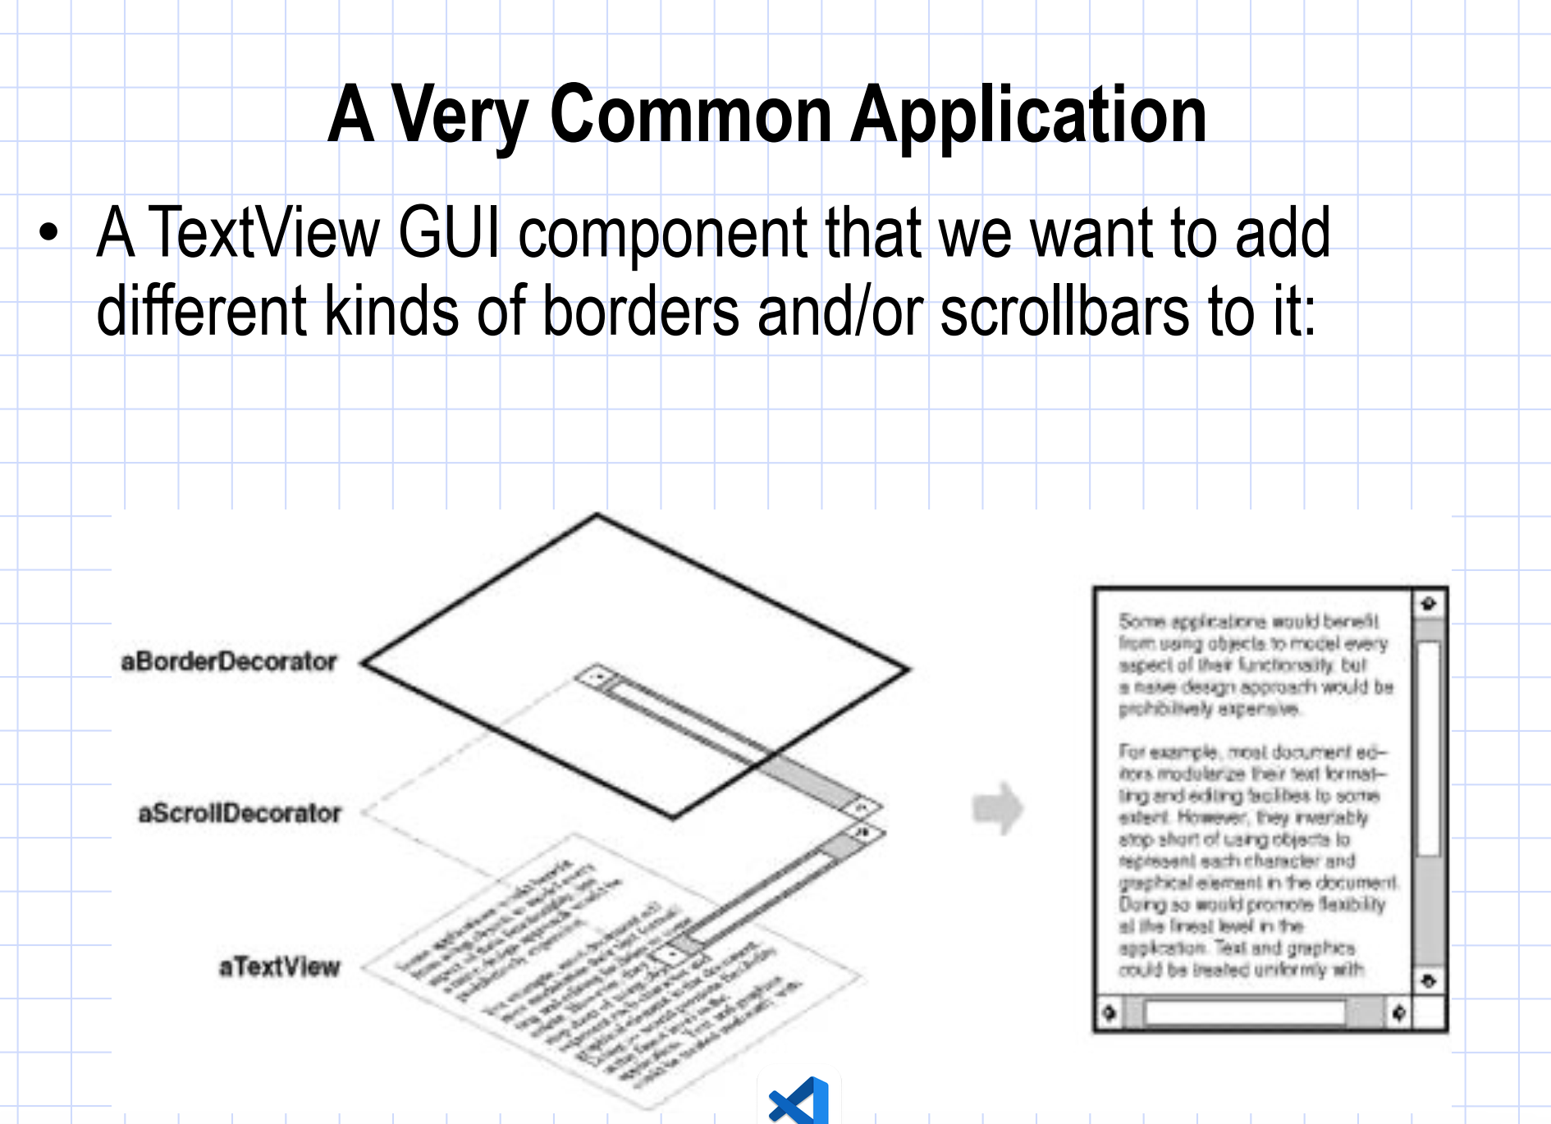
Notes:
You have a TextView component (a basic text box in a graphical user interface) that displays text. Now, you want to extend this basic functionality by adding:
Borders (to visually frame the text).
Scrollbars (to allow scrolling through large amounts of text).
Instead of creating separate classes for every possible combination of these features (e.g., a class for TextViewWithBordersAndScrollbars, TextViewWithBordersOnly, etc.), you can use the Decorator Pattern to dynamically add these features as needed.

Slide 10
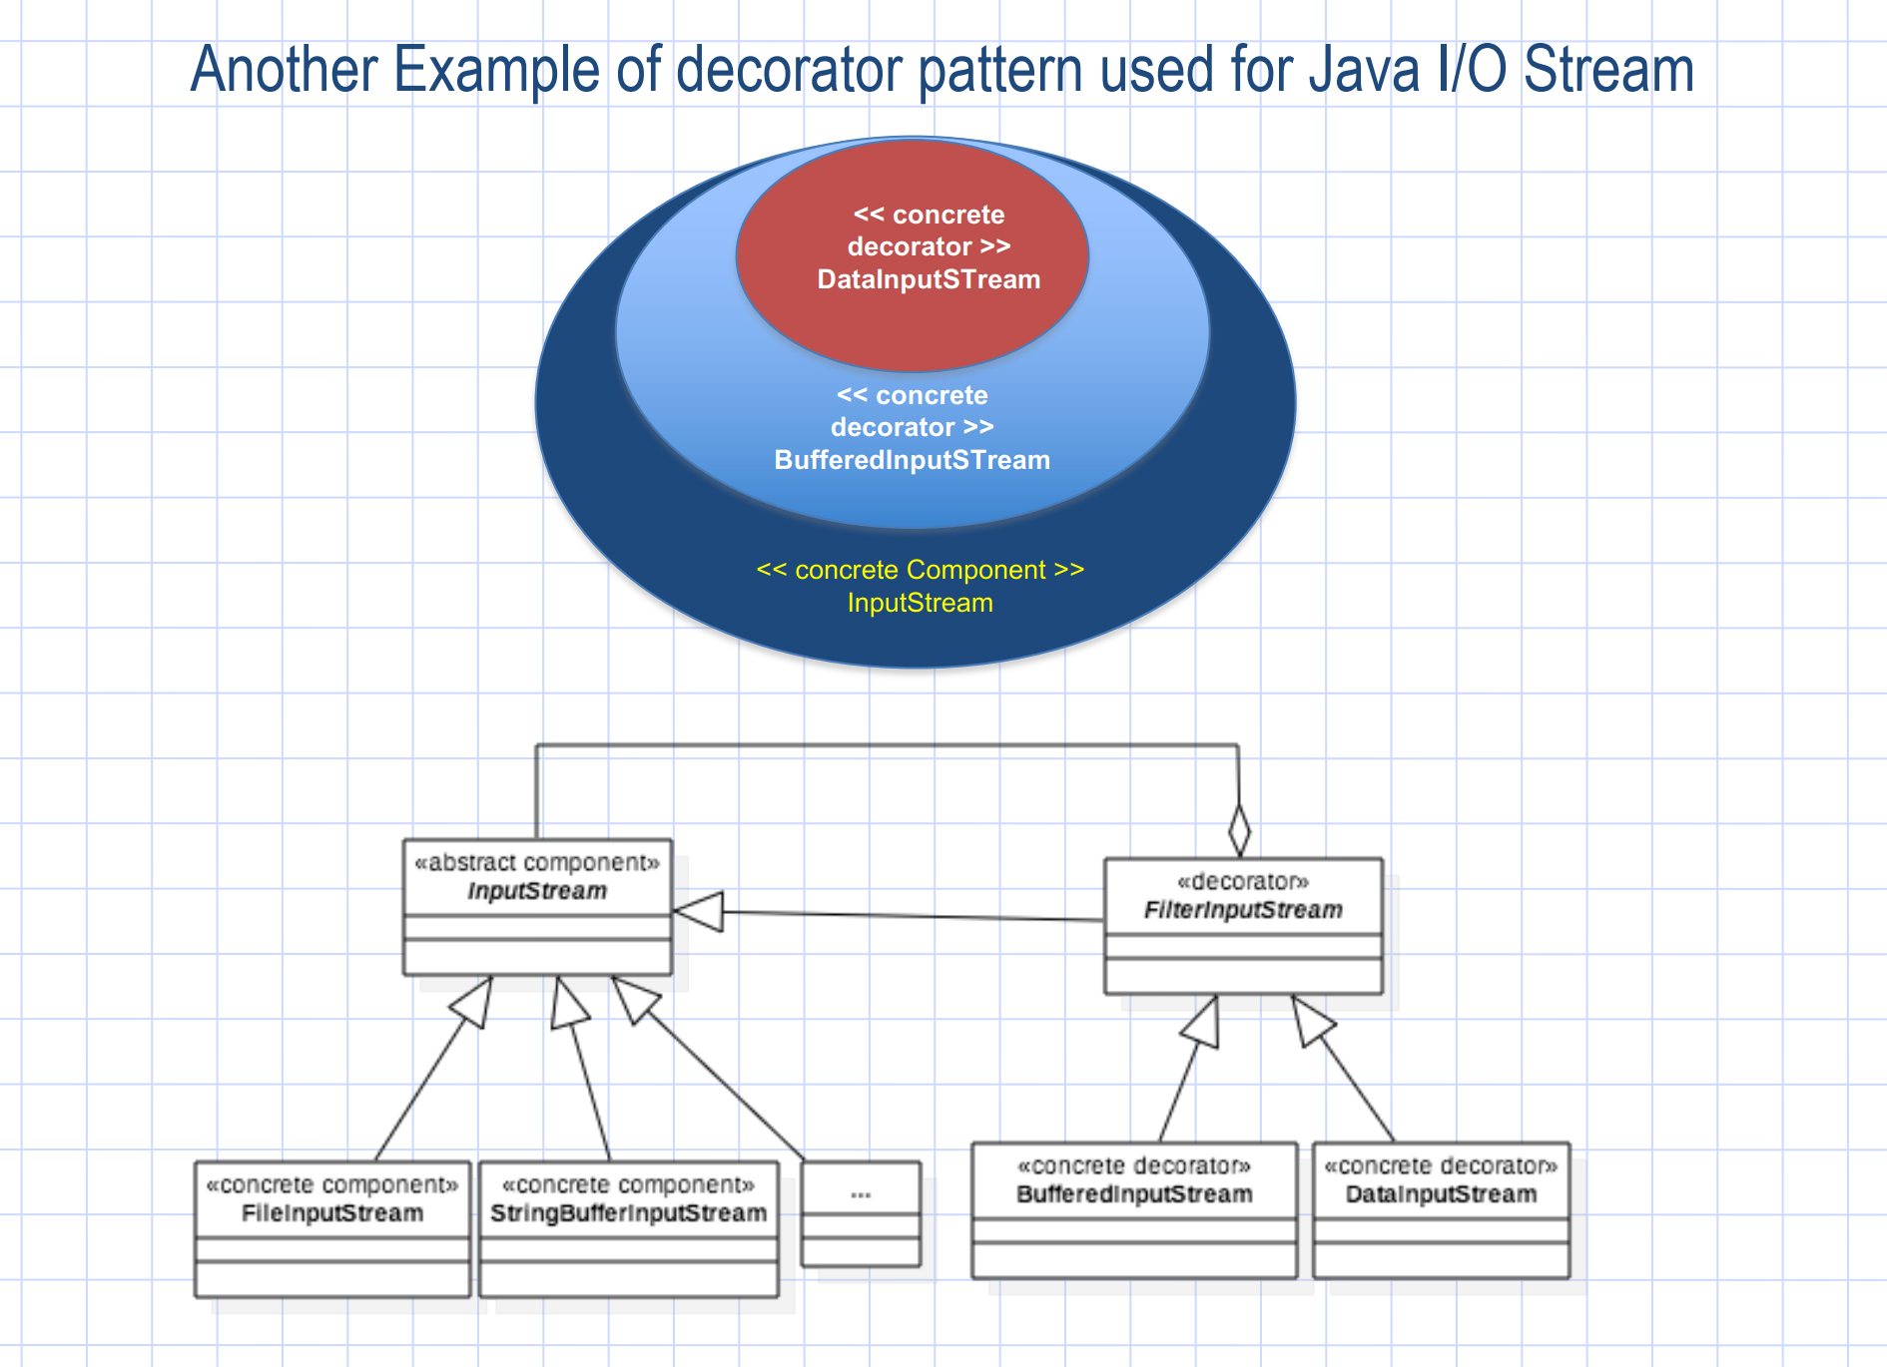
InputStream fileStream = new FileInputStream("example.txt");
InputStream bufferedStream = new BufferedInputStream(fileStream);
DataInputStream dataStream = new DataInputStream(bufferedStream);
int data = dataStream.readInt(); stream

Slide 11
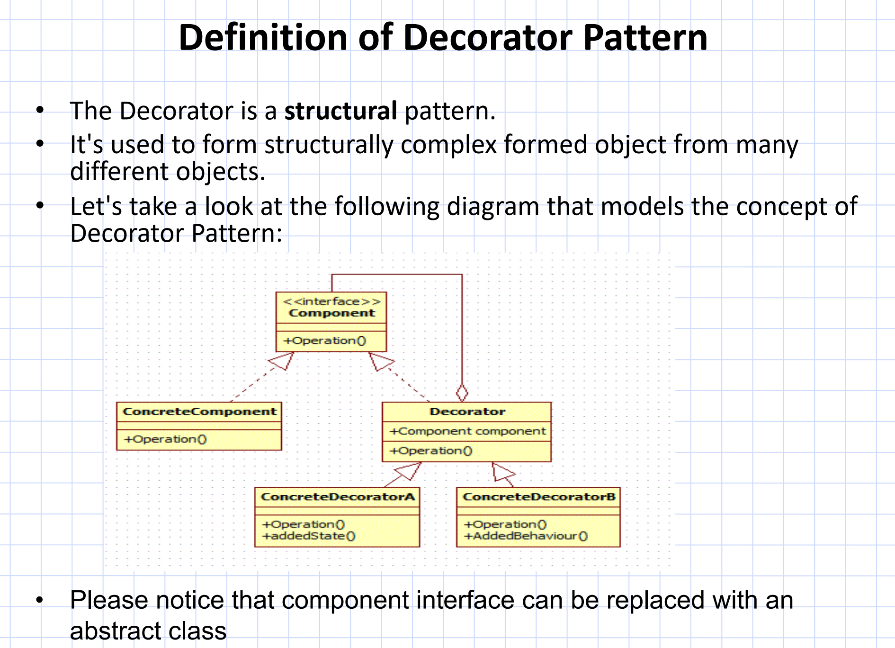
Notes:
The Decorator Pattern is a Structural Pattern:
This means it focuses on how classes and objects are composed to form larger, more complex structures.
The goal of the Decorator Pattern is to provide a flexible alternative to subclassing for extending functionality. Instead of creating numerous subclasses for every possible feature combination, you use decorators to wrap objects and add features dynamically.
Purpose:
It’s used to form structurally complex objects from many different parts (decorators). Each part adds new behavior or functionality, while keeping the underlying object intact.
Decorator:This is an abstract class (or it could also be an interface) that wraps a Component. It contains a reference to the Component it decorates, allowing the decorator to forward method calls to the underlying component while adding extra behavior.
The decorator itself implements the Component interface, which means it can be treated as a Component and thus wrapped by another decorator, allowing for layering of functionality.

Slide 12
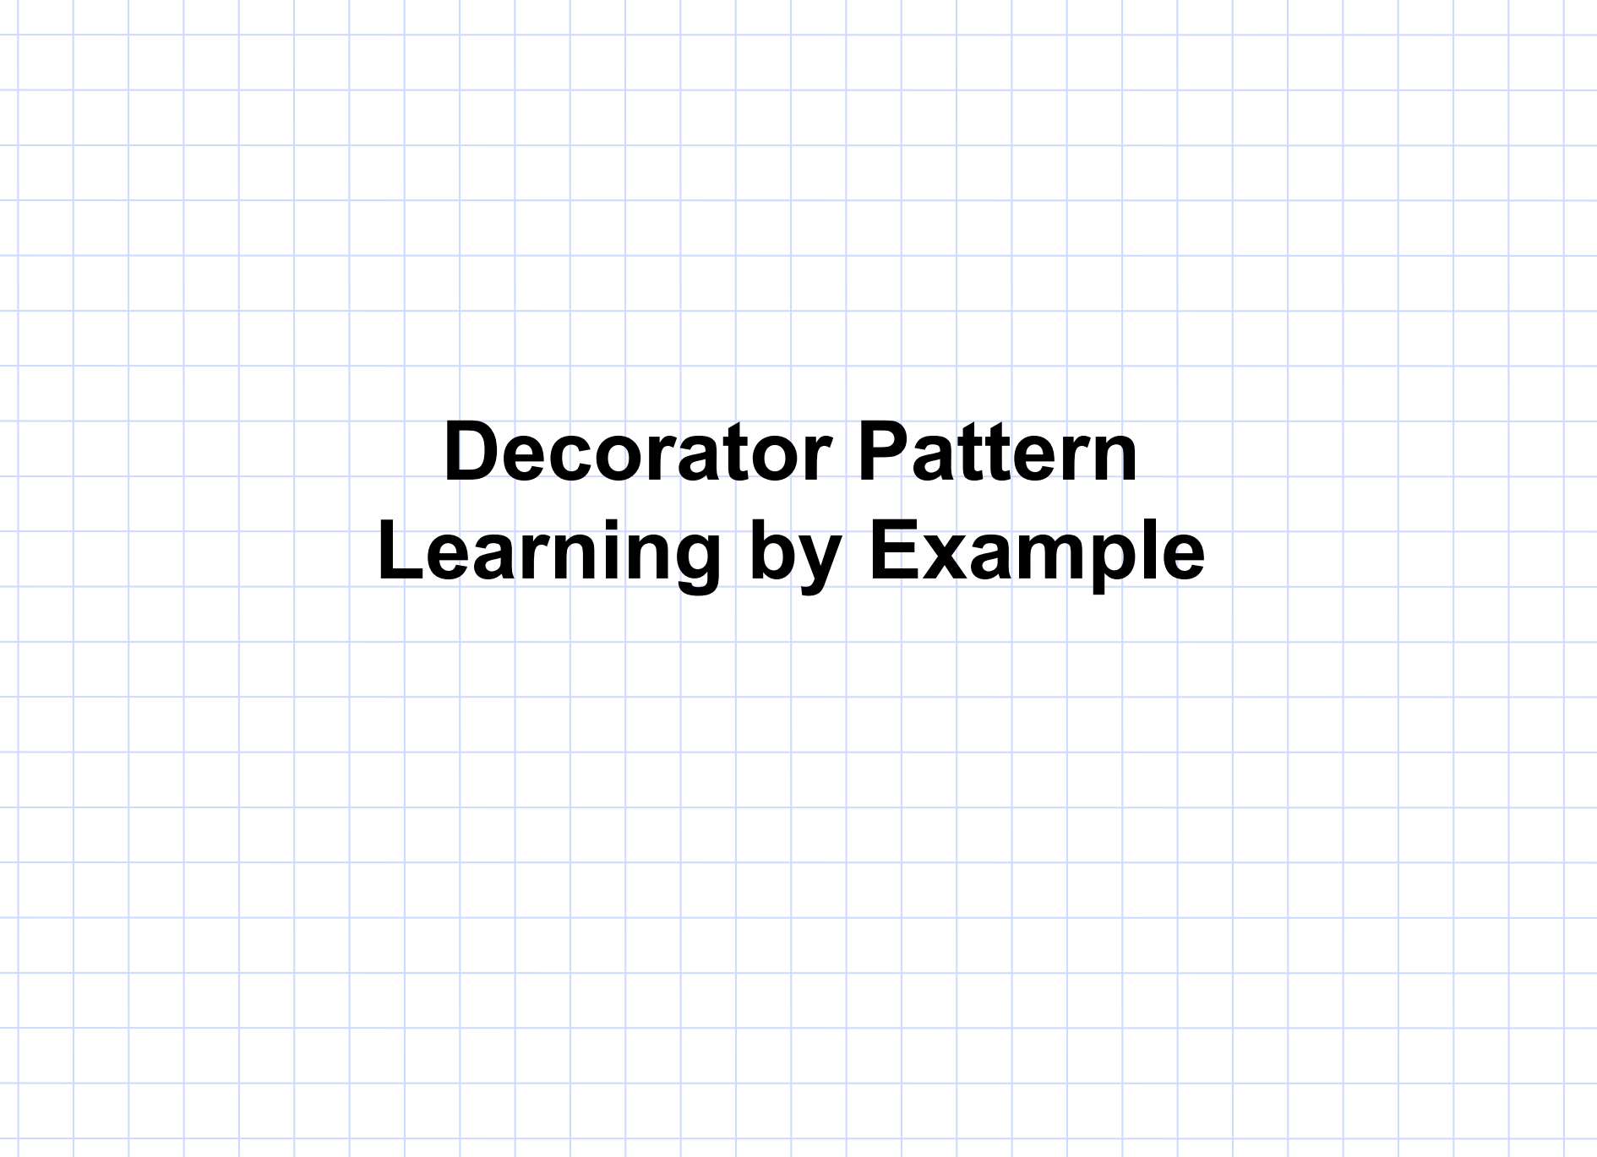

Slide 13

Component Interface (Tea)
class Tea {
public:
virtual ~Tea() = default;
virtual std::string description() const = 0; // Pure virtual function for description
virtual double cost() const = 0; // Pure virtual function for cost
};
Notes:
Tea is a base abstract class that enforces every tea type to have a description() and cost() method.
This interface is pure virtual because it doesn’t provide implementations for the methods, making Tea an abstract class.
= default; specifies that we’re using the default implementation provided by C++. This keeps the code simple but signals that the class is designed to be a base class, with proper cleanup if derived objects are deleted through a base pointer.

Slide 14
Concrete Component (Matcha)
class Matcha : public Tea {
public:
std::string description() const override {
return "Matcha Tea";
}
double cost() const override {
return 3.00;
}
};
Notes:
Tea is a base abstract class that enforces every tea type to have a description() and cost() method.
This interface is pure virtual because it doesn’t provide implementations for the methods, making Tea an abstract class.
= default; specifies that we’re using the default implementation provided by C++. This keeps the code simple but signals that the class is designed to be a base class, with proper cleanup if derived objects are deleted through a base pointer.

Slide 15

Decorator Abstract Class (IngredientDecorator)
class IngredientDecorator : public Tea {
protected:
std::shared_ptr<Tea> tea; // Holds the tea to be decorated
public:
IngredientDecorator(std::shared_ptr<Tea> t) : tea(t) {}
};
Notes:
class IngredientDecorator : public Tea { ... };
IngredientDecorator inherits from Tea, which means it must implement description() and cost().
By inheriting from Tea, IngredientDecorator can act as a tea itself. This lets it wrap any Tea object, whether it’s a Matcha or another decorator.
Protected Member tea:
std::shared_ptr<Tea> tea;: This member variable holds a reference to the Tea object that the decorator will wrap.
Using std::shared_ptr allows for dynamic memory management, enabling flexible object wrapping at runtime.
std::shared_ptr is part of the C++ Standard Library, specifically within the <memory> header. It’s a type of smart pointer that manages the lifetime of a dynamically allocated object through reference counting. When you use std::shared_ptr, multiple parts of your program can own the same object, and it will automatically be deallocated when the last shared_ptr pointing to it is destroyed.

Slide 16

Concrete Decorators
class Honey : public IngredientDecorator {
public:
Honey(std::shared_ptr<Tea> t) : IngredientDecorator(t) {}
std::string description() const override {
return tea->description() + ", Honey"; // Adds Honey to description
}
double cost() const override {
return tea->cost() + 0.50; // Adds Honey's cost
}
};
Notes:
Constructor Honey(std::shared_ptr<Tea> t):
This constructor takes a Tea object (t) and passes it to the IngredientDecorator constructor, initializing the tea reference. This allows Honey to wrap and add functionality on top of the provided Tea.
description() Method:
description() first calls tea->description() to get the existing description (such as “Matcha Tea”).
It then adds ", Honey", appending “Honey” to the description.
This approach maintains the description of the original tea and then layers on the honey addition, allowing any previously added decorations to be retained.

Slide 17
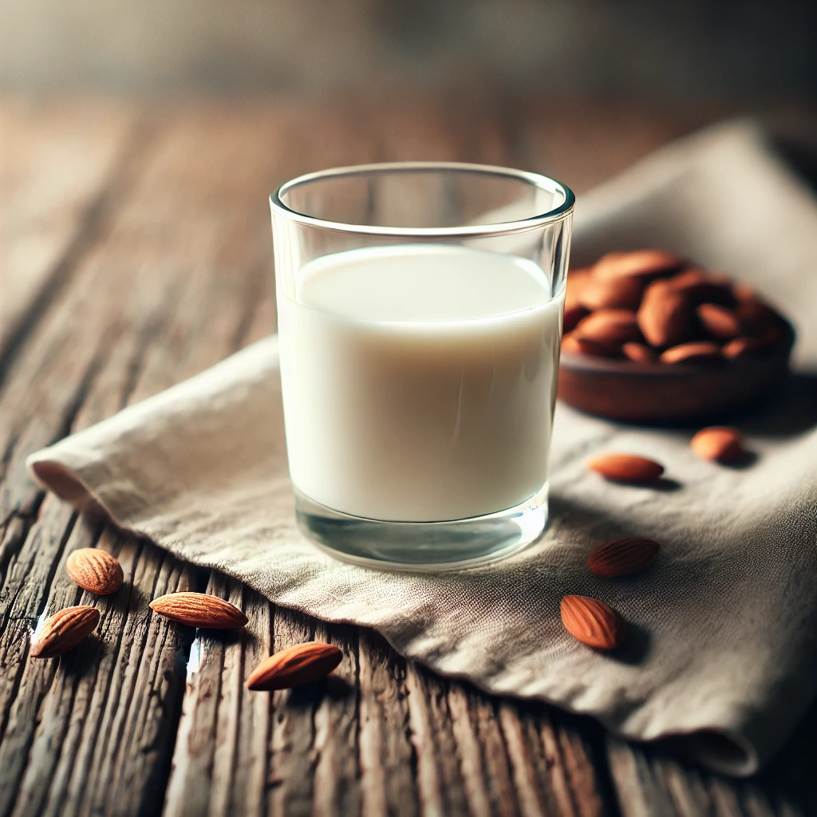
Concrete Decorators
class AlmondMilk : public IngredientDecorator {
public:
AlmondMilk(std::shared_ptr<Tea> t) : IngredientDecorator(t) {}
std::string description() const override {
return tea->description() + ", Almond Milk"; // Adds Almond Milk to description
}
double cost() const override {
return tea->cost() + 0.75; // Adds Almond Milk's cost
}
};
Notes:
Constructor Honey(std::shared_ptr<Tea> t):
This constructor takes a Tea object (t) and passes it to the IngredientDecorator constructor, initializing the tea reference. This allows Honey to wrap and add functionality on top of the provided Tea.
description() Method:
description() first calls tea->description() to get the existing description (such as “Matcha Tea”).
It then adds ", Honey", appending “Honey” to the description.
This approach maintains the description of the original tea and then layers on the honey addition, allowing any previously added decorations to be retained.

Slide 18

Concrete Decorators
class Cinnamon : public IngredientDecorator {
public:
Cinnamon(std::shared_ptr<Tea> t) : IngredientDecorator(t) {}
std::string description() const override {
return tea->description() + ", Cinnamon"; // Adds Cinnamon to description
}
double cost() const override {
return tea->cost() + 0.25; // Adds Cinnamon's cost
}
};
Notes:
Constructor Honey(std::shared_ptr<Tea> t):
This constructor takes a Tea object (t) and passes it to the IngredientDecorator constructor, initializing the tea reference. This allows Honey to wrap and add functionality on top of the provided Tea.
description() Method:
description() first calls tea->description() to get the existing description (such as “Matcha Tea”).
It then adds ", Honey", appending “Honey” to the description.
This approach maintains the description of the original tea and then layers on the honey addition, allowing any previously added decorations to be retained.

Slide 19
Decorated Tea
int main() {
std::shared_ptr<Tea> myTea = std::make_shared<Matcha>(); // Start with plain Matcha Tea
myTea = std::make_shared<Honey>(myTea); // Add Honey
myTea = std::make_shared<AlmondMilk>(myTea); // Add Almond Milk
myTea = std::make_shared<Cinnamon>(myTea); // Add Cinnamon
std::cout << "Order: " << myTea->description() << "\n"; // Output: Matcha Tea, Honey, Almond Milk, Cinnamon
std::cout << "Cost: $" << myTea->cost() << "\n"; // Output: Total cost with all add-ons
return 0;
}
Notes:
This line creates a base tea object of type Matcha and assigns it to myTea, which is a std::shared_ptr to Tea.
myTea holds a reference to the base Matcha tea, which has a description of "Matcha Tea" and a cost of 3.00.
std::make_shared is a C++ utility function that simplifies the process of creating and managing shared pointers. Shared pointers are smart pointers, defined in the <memory> header, that automatically handle the memory of dynamically allocated objects.

Slide 20
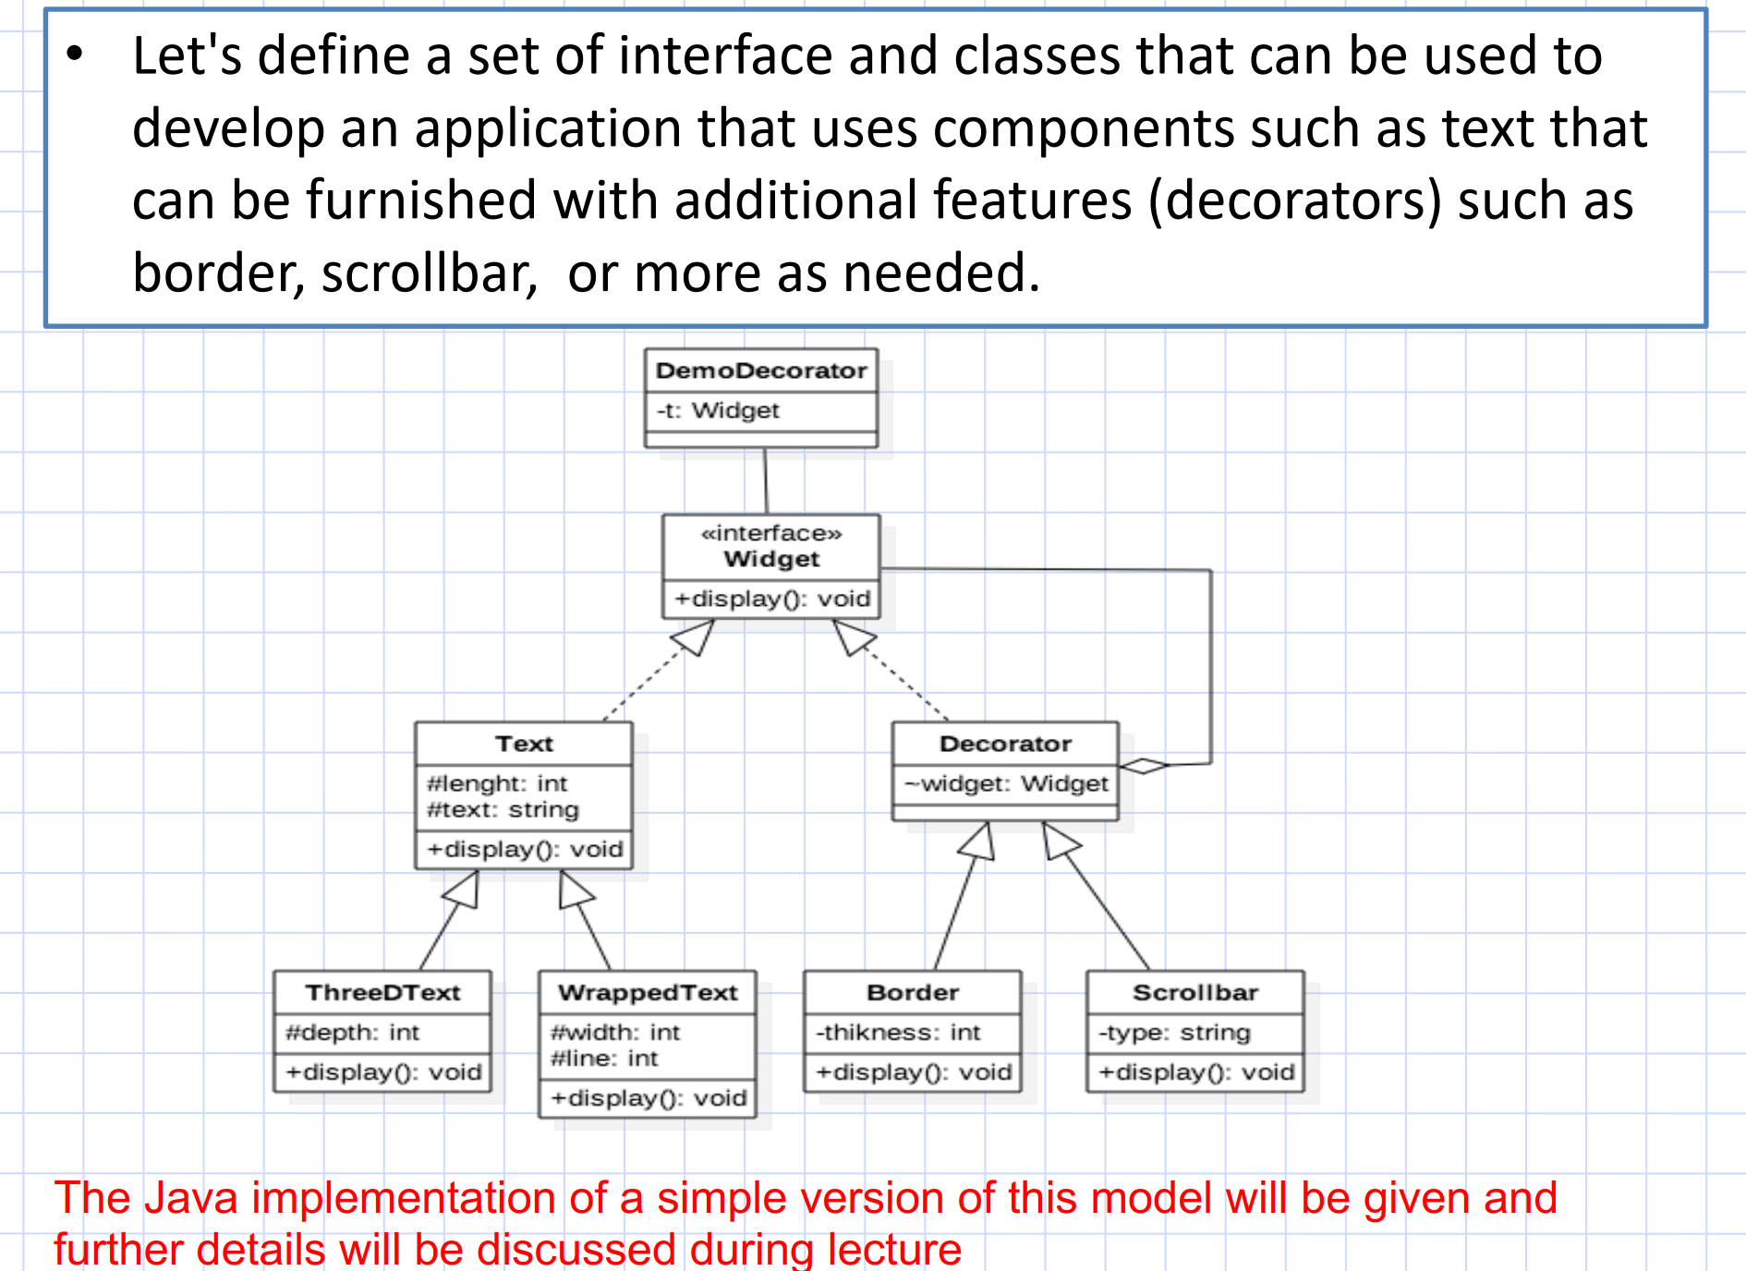

Slide 21
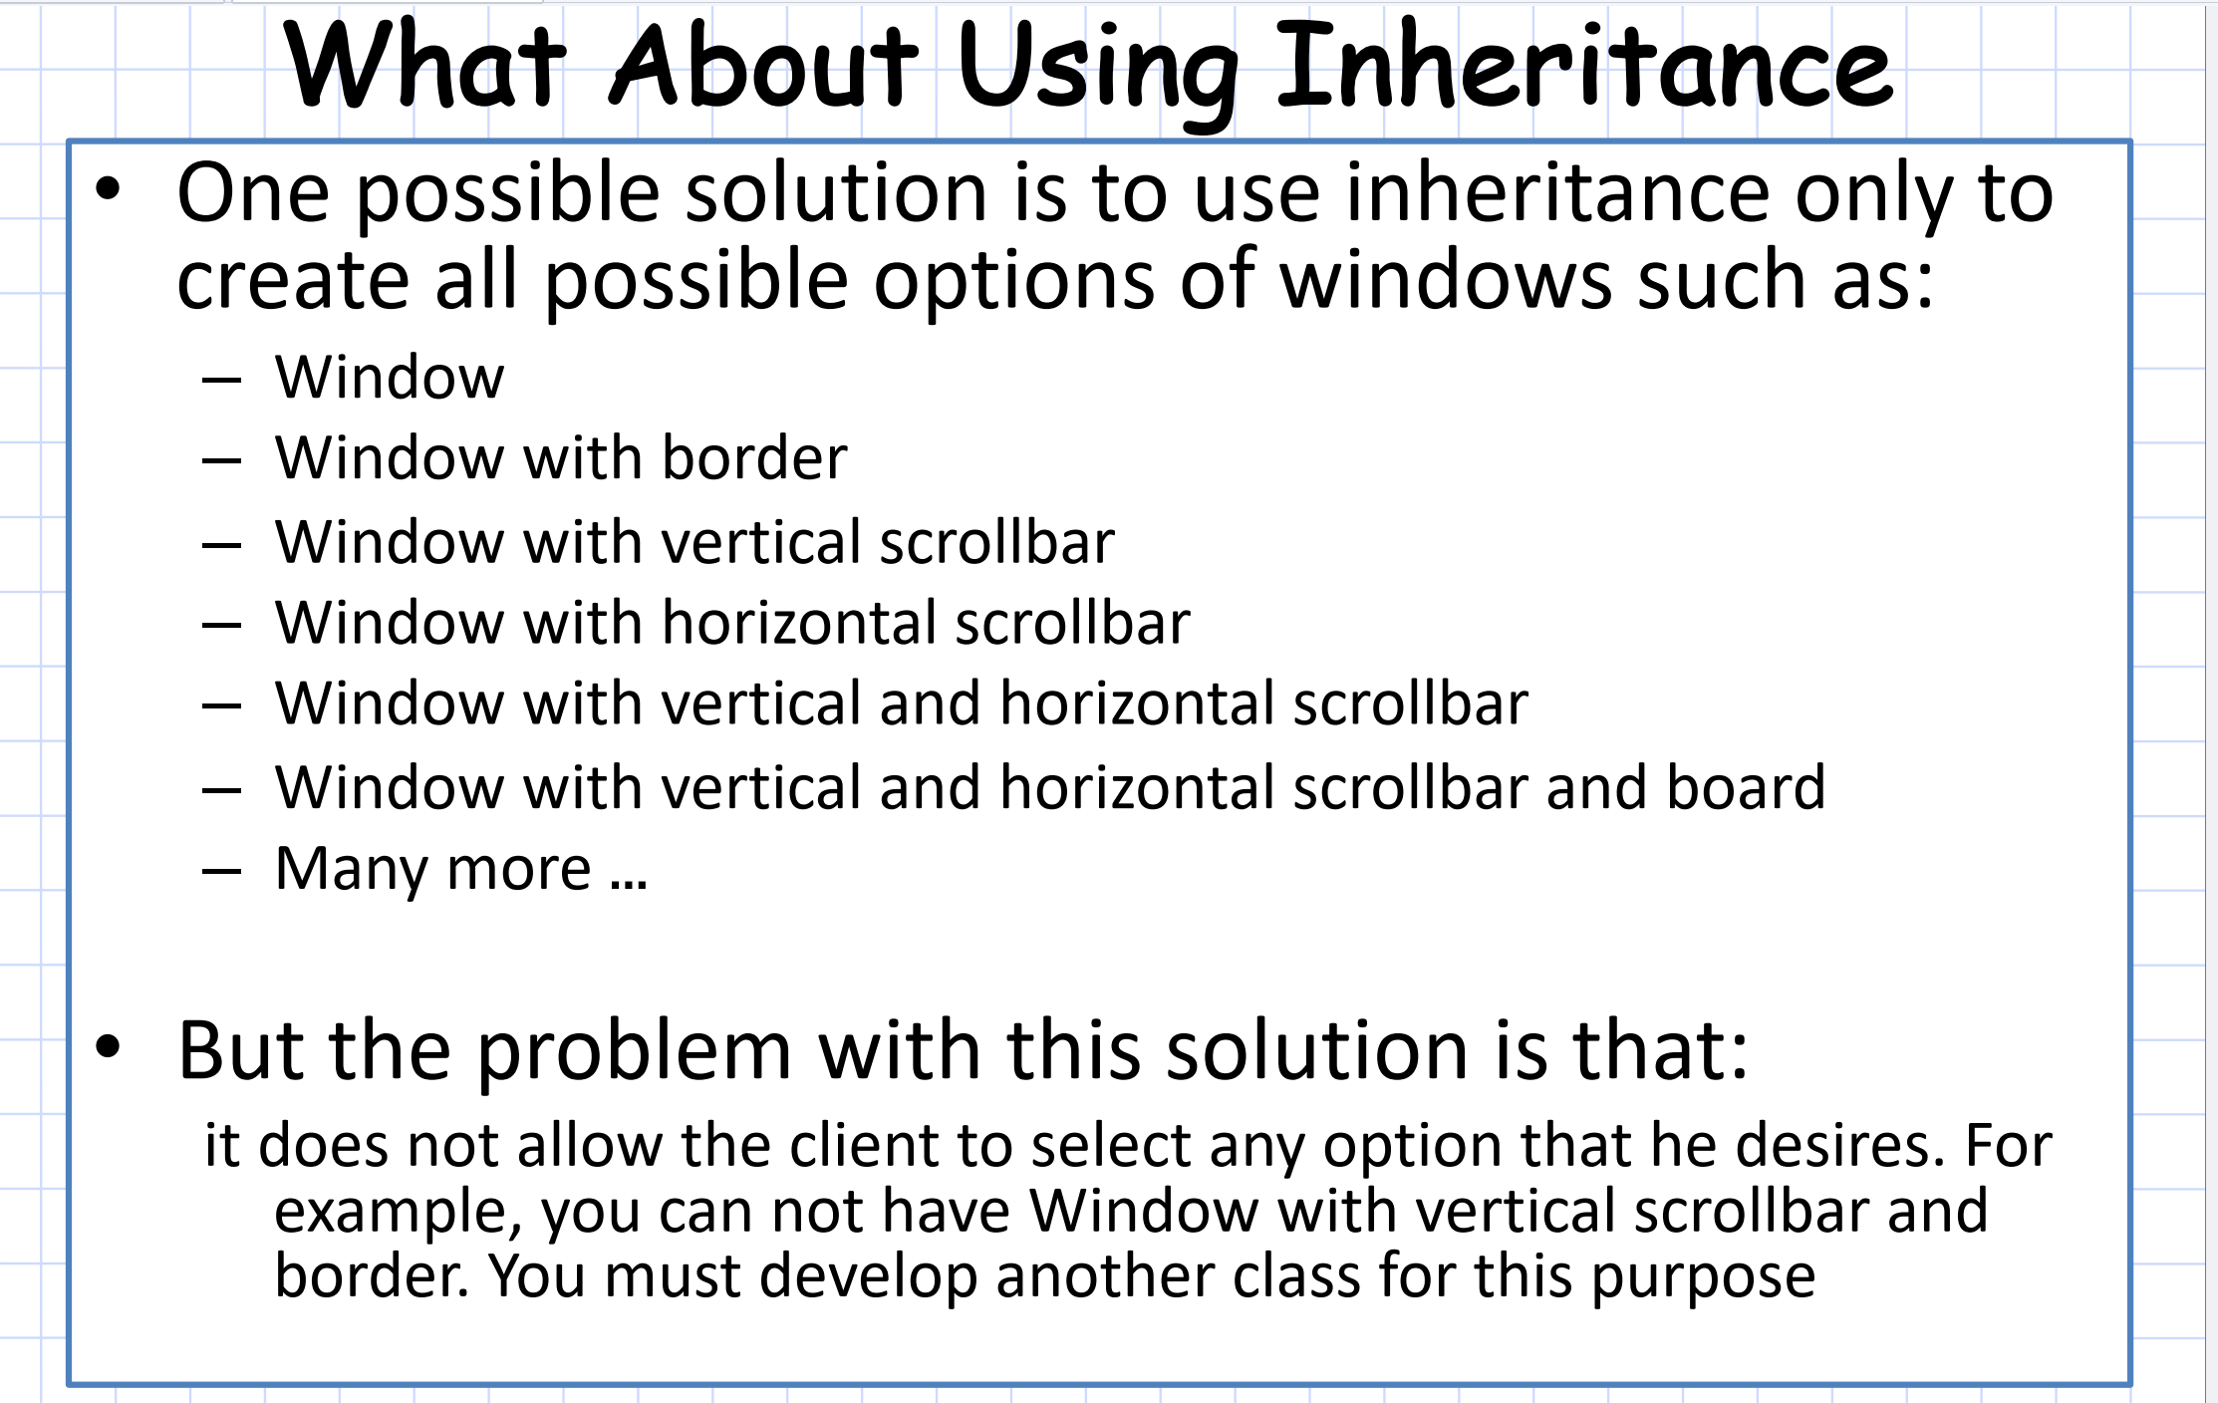
Notes:
The slide suggests an approach where each combination of a window feature (such as a border or scrollbar) is handled by creating a new subclass. For example:
The problem with using inheritance like this is the combinatorial explosion of subclasses. With each new feature (border, scrollbar, etc.), you would need to create a new subclass for every possible combination of features. This leads to several issues:
Limited Flexibility: You can’t easily combine features dynamically. If a new combination of features is needed (e.g., a window with both a vertical scrollbar and a border), you have to create a new class.
Class Explosion: For every new feature or combination, a new class must be created. If you have multiple features (e.g., vertical scrollbar, horizontal scrollbar, border, title bar, etc.), the number of combinations grows exponentially.
Complexity: The system becomes difficult to maintain and extend. If a new feature is introduced, you must modify many classes to accommodate it.

Slide 22
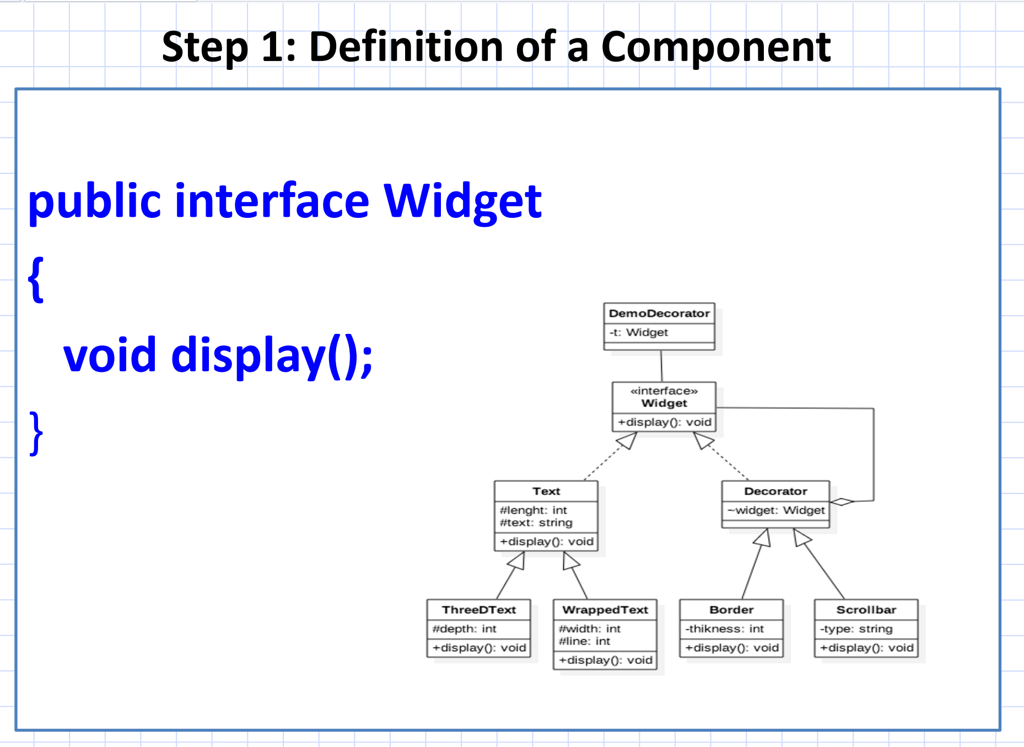

Slide 23
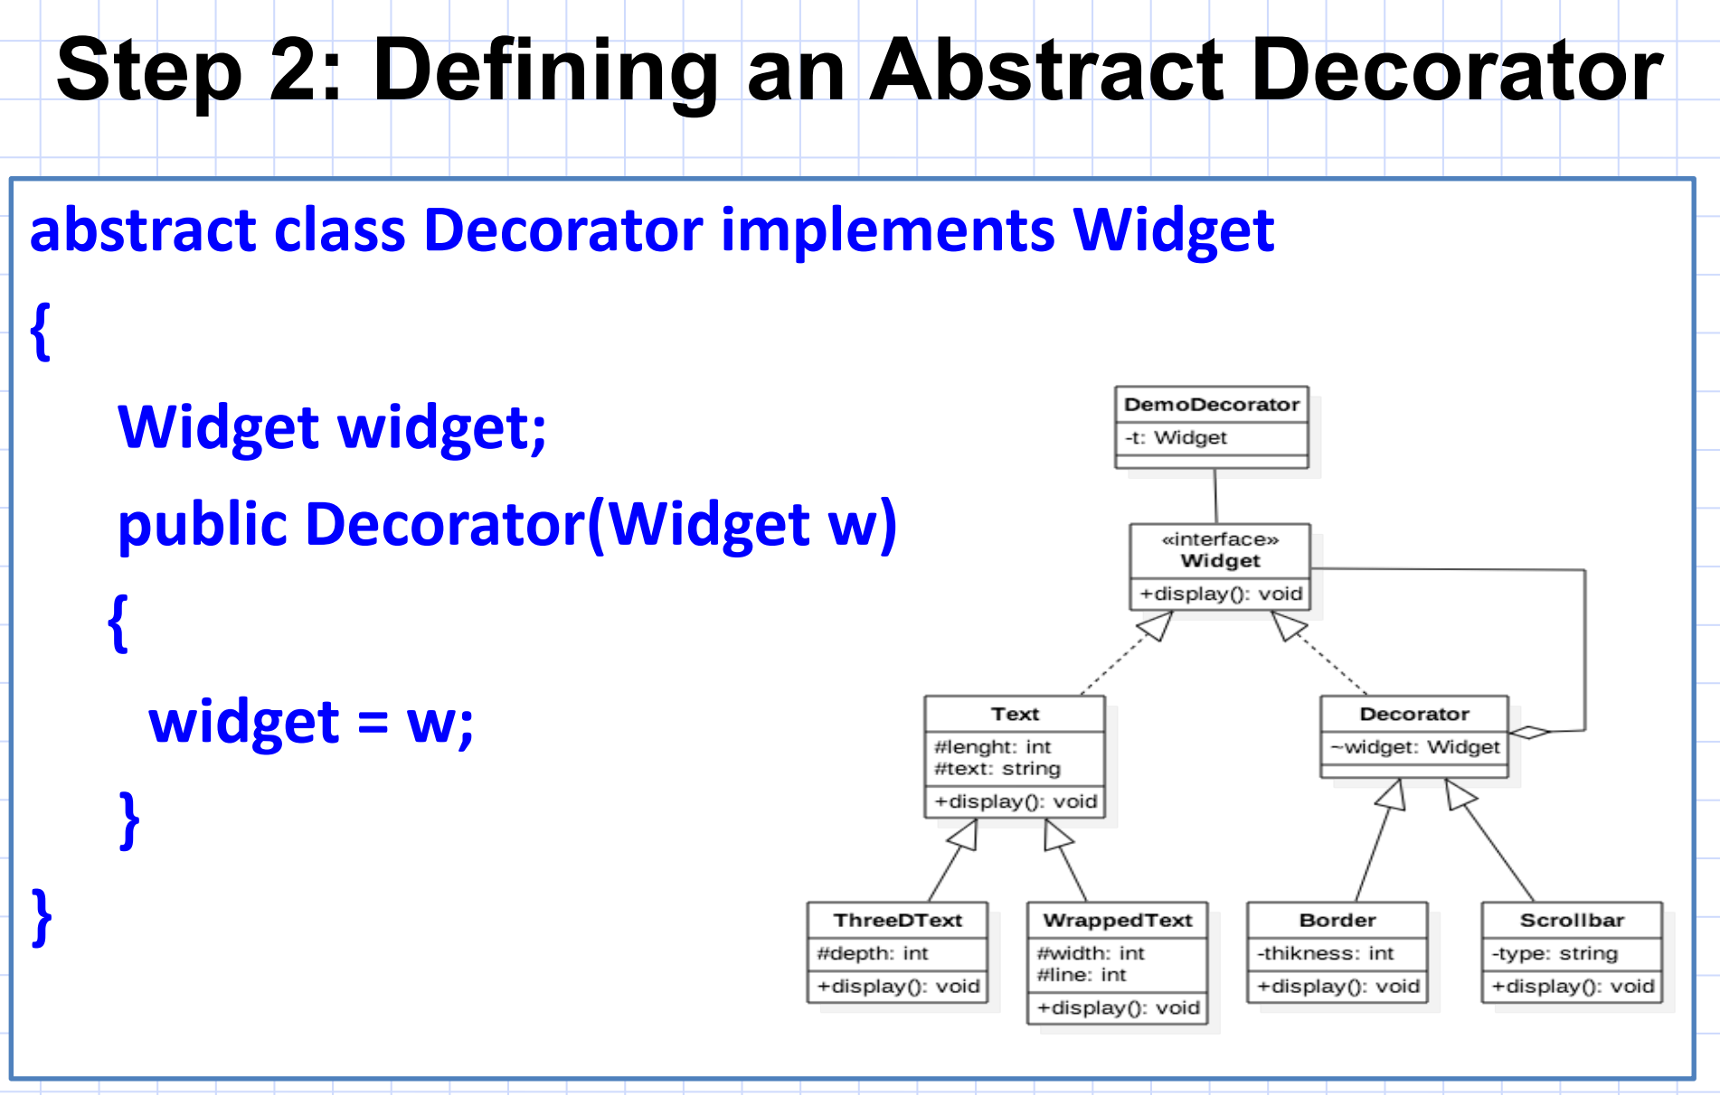
Notes:
Widget widget;:
This is a reference to the object of type Widget that the decorator wraps around.
This widget can be any class that implements the Widget interface, including both base components (like Text) and other decorators. This allows decorators to be layered dynamically.

Slide 24
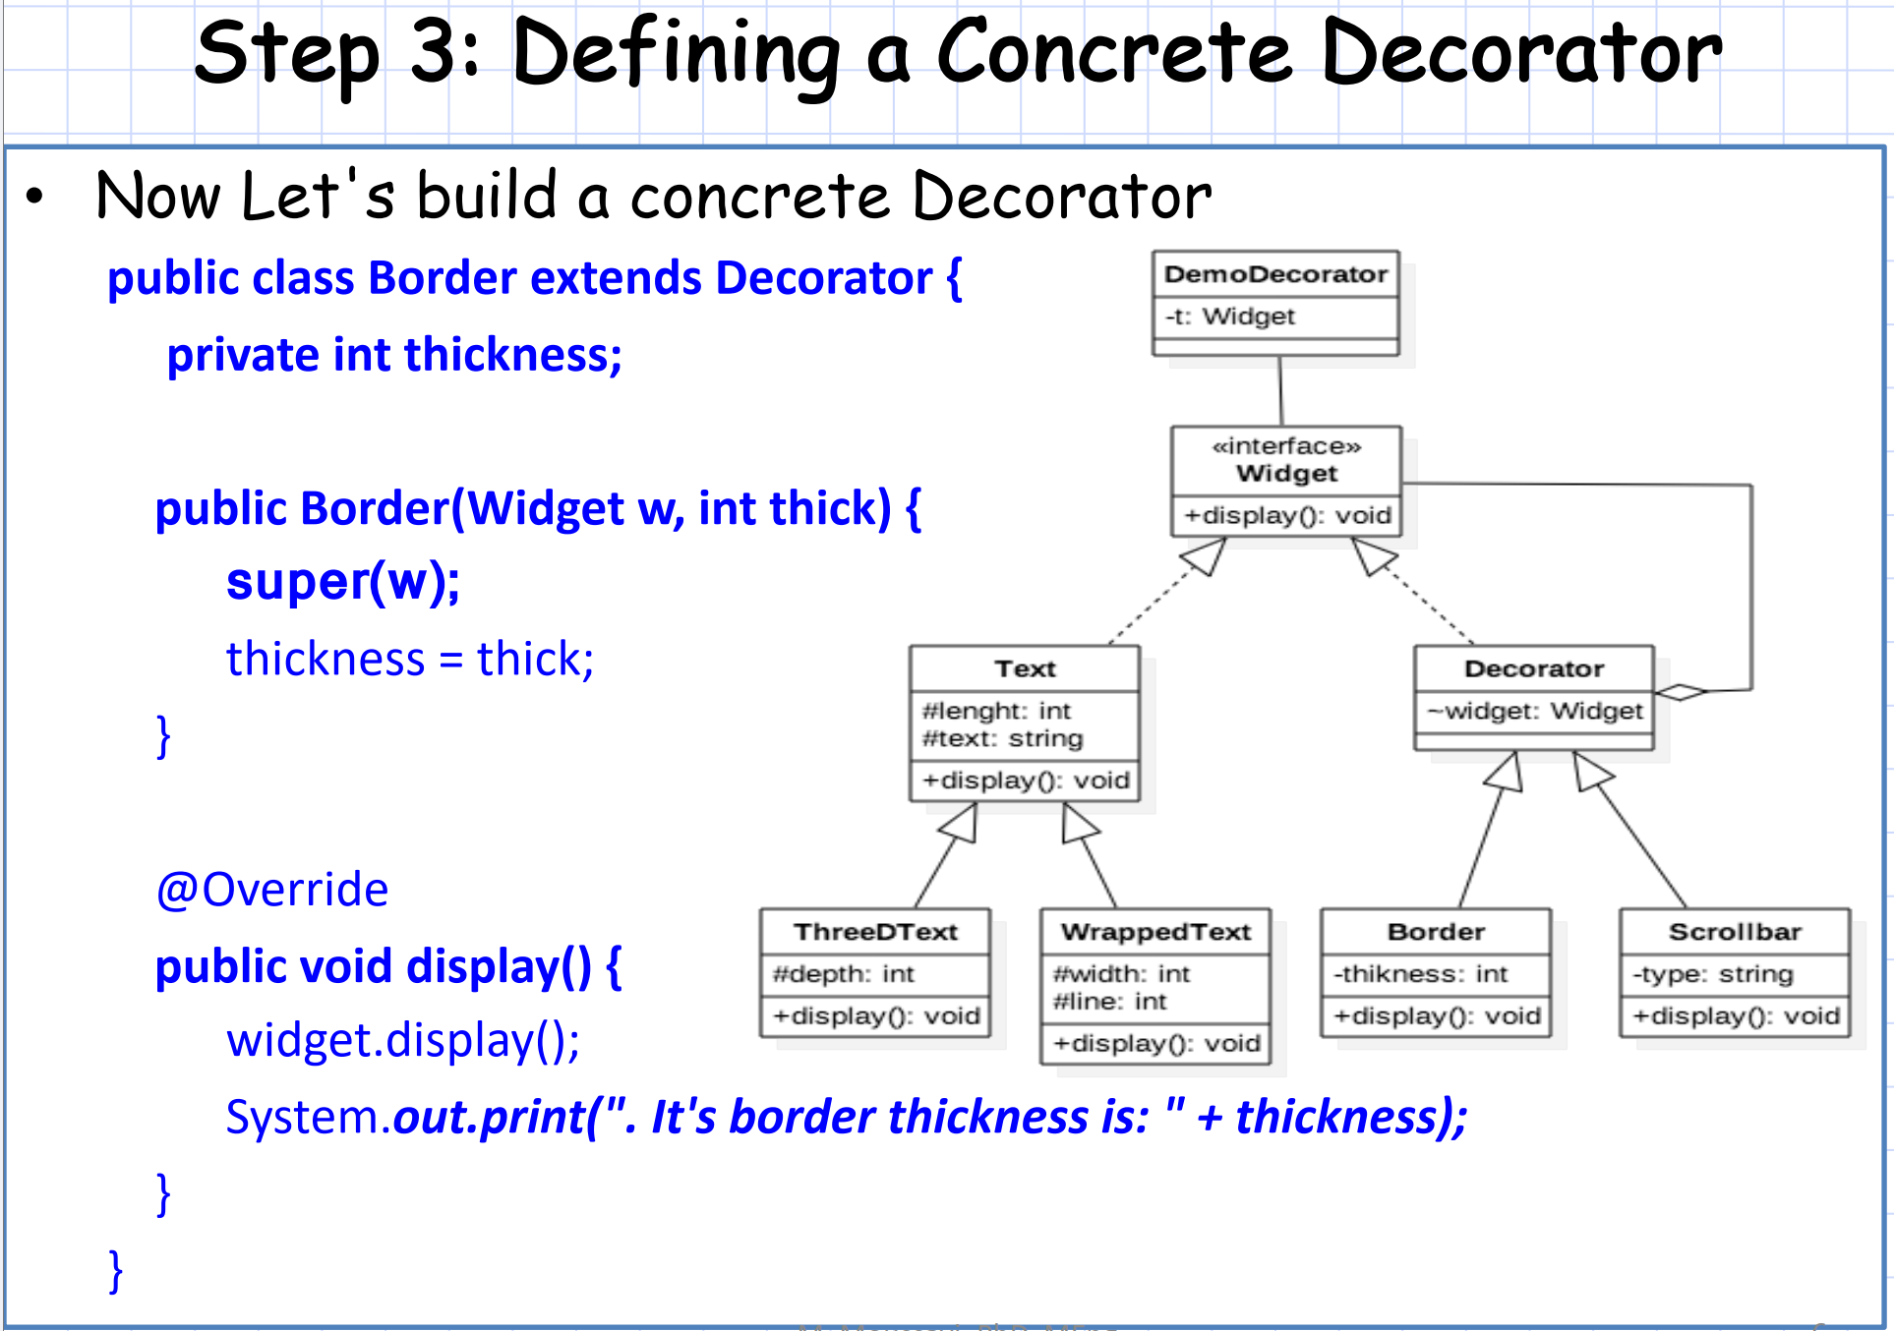

Slide 25
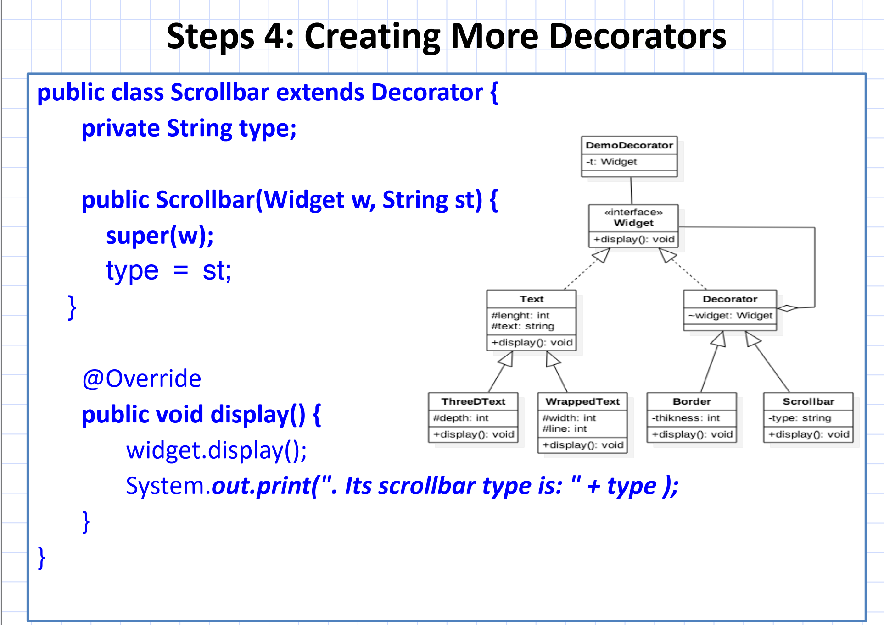

Slide 26
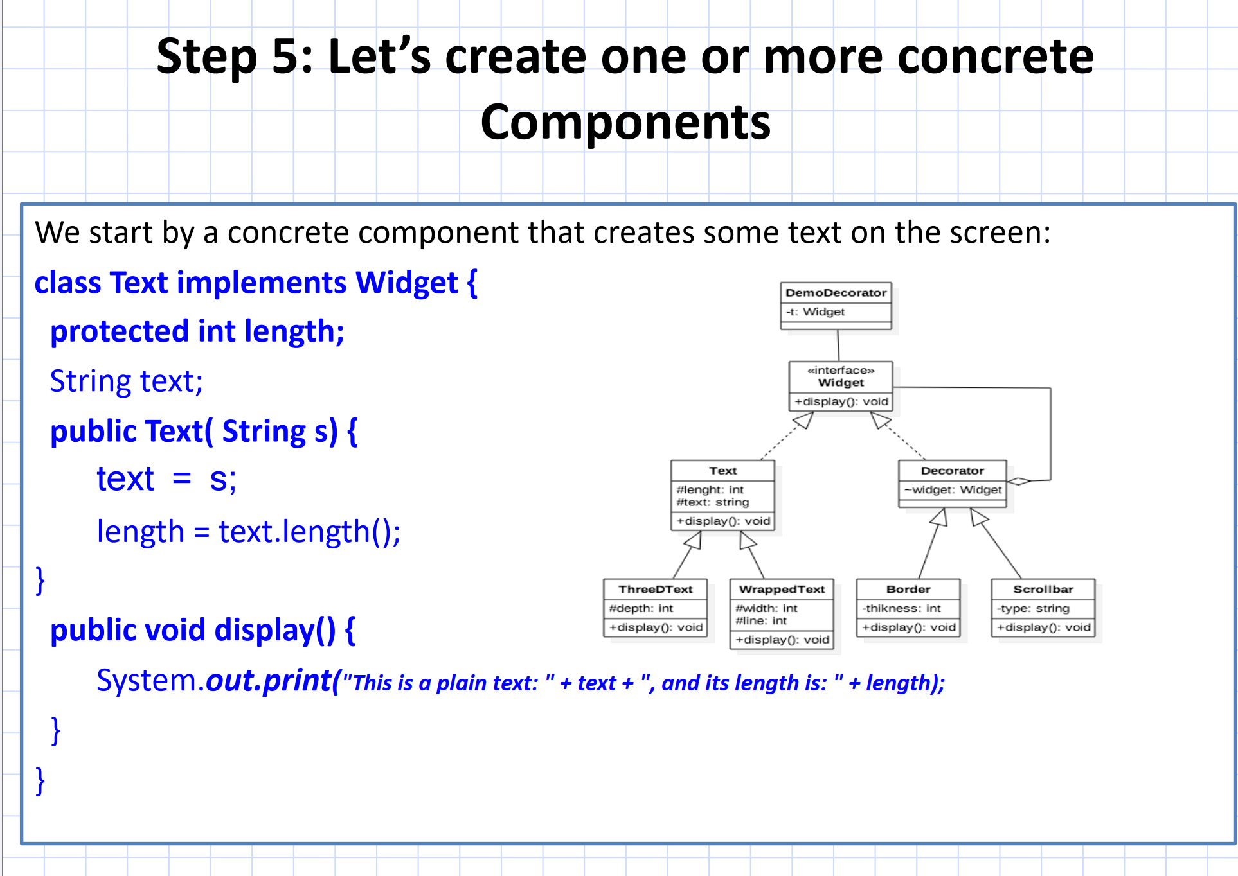

Slide 27
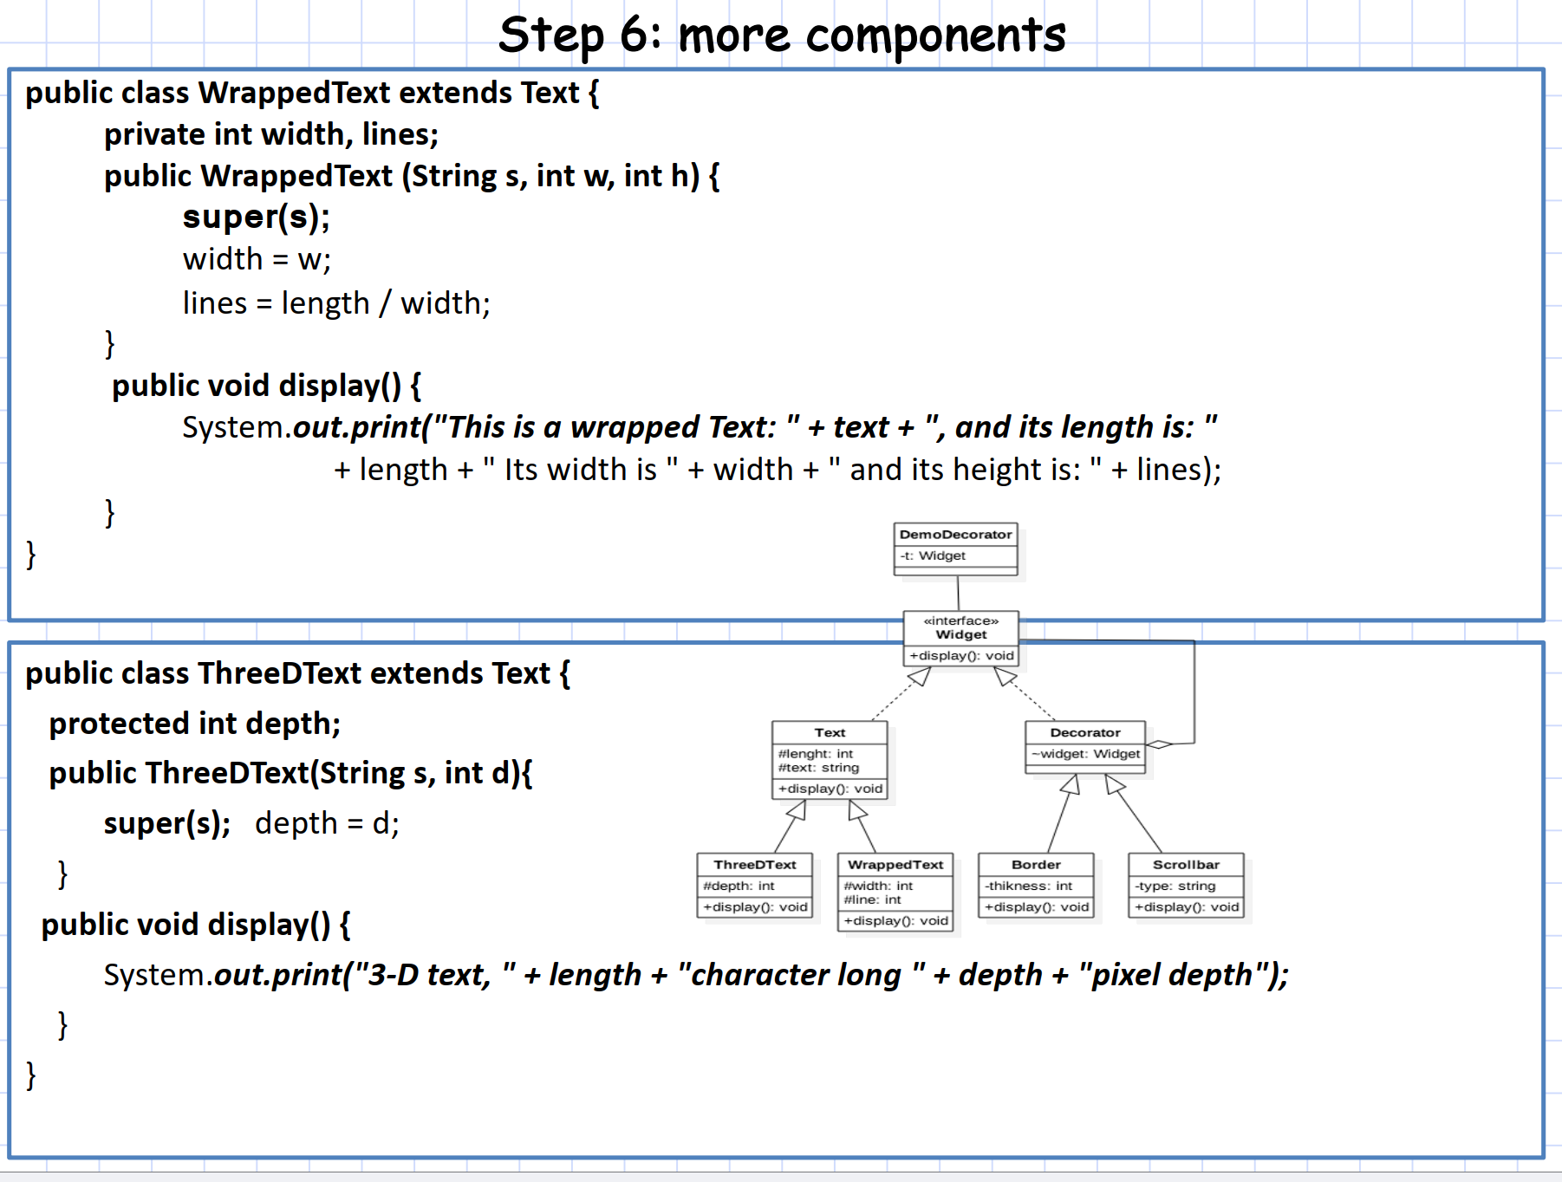

Slide 28
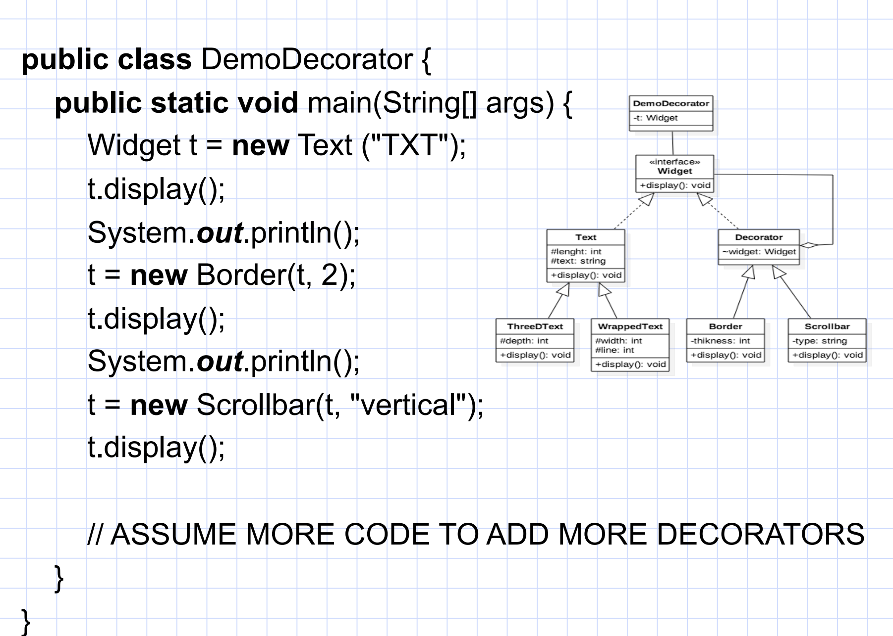

Slide 29
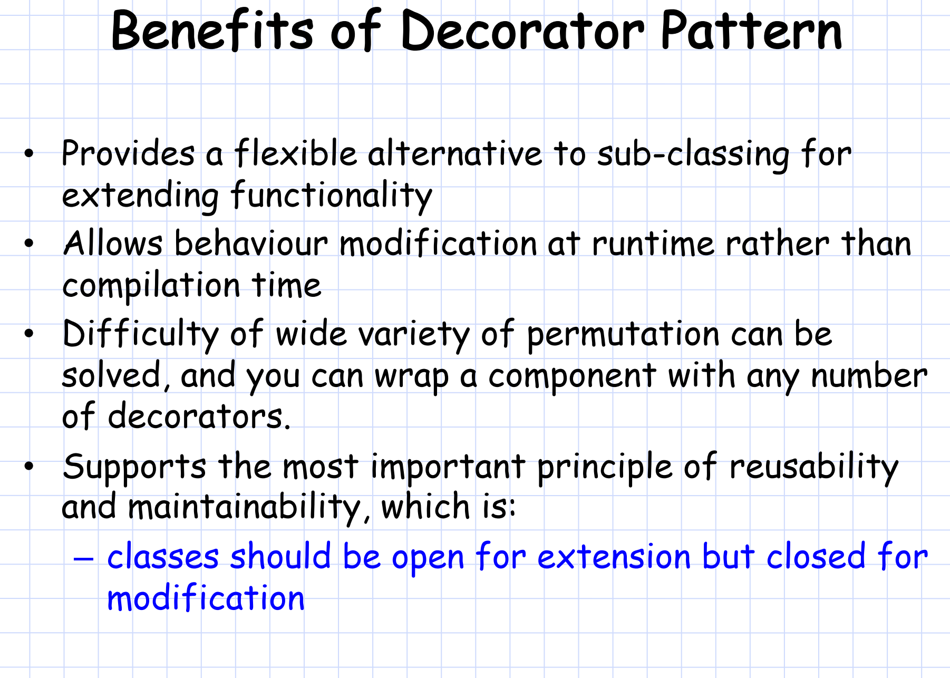
Notes:
Flexible Alternative to Subclassing:
The Decorator Pattern provides a more flexible approach to extending functionality compared to subclassing. Instead of creating many subclasses for different combinations of behaviors, decorators allow you to dynamically add or modify functionality by wrapping objects.
Example: Instead of having multiple subclasses like WindowWithBorder, WindowWithScrollbar, etc., you can dynamically wrap a Window object with Border or Scrollbar decorators.
Behavior Modification at Runtime:
Unlike subclassing, which requires all behaviors to be defined at compile time, the Decorator Pattern allows you to modify an object's behavior at runtime. This means you can choose which decorators to apply based on runtime conditions, adding more flexibility to your design.
Example: In the demo, a Text object can be wrapped with a Border and a Scrollbar dynamically, based on user input or other runtime factors.
Solving the Difficulty of Permutations:
One of the major benefits of the Decorator Pattern is that it resolves the issue of managing many different permutations of features. Instead of creating a separate subclass for each combination of features (border, scrollbar, title bar, etc.), you can compose the desired combination by wrapping a component with multiple decorators.
Example: You can wrap a component with any number of decorators (e.g., adding a border, a vertical scrollbar, a horizontal scrollbar, etc.), which reduces the need for a large hierarchy of classes.
Supports Reusability and Maintainability:
The Decorator Pattern adheres to the Open/Closed Principle, a key design principle that states that classes should be open for extension but closed for modification. This means that you can extend the functionality of objects (by adding new decorators) without modifying the existing code of those objects.
Example: You can add new decorators (e.g., a TitleBar decorator) without changing the original Text class or the existing decorators (Border, Scrollbar).

